Slide 1









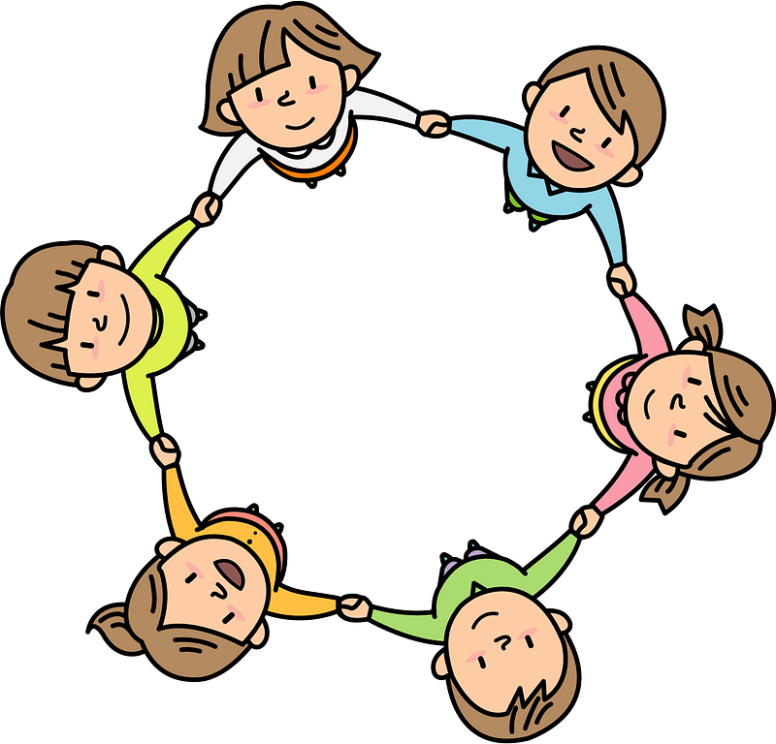

Curriculum Overview Year 6
Advent Term 2023
Please find below information about what your child will be learning this term.
If you would like more information speak to your child’s teacher.
Literacy
Key Texts to Study:
The Journey – Aaron Becker – Wordless picture book
Wisp - Zana Fraillon – Fiction Picture book
Planetarium – Raman Prinja – Non-Fiction
Night of the Gargoyles – Eve Bunting – Mythological Fiction
A Christmas Carol – Charles Dickens – Classic Fiction
Holes – Louis Sachar – Adventure Fiction
Types of writing:
Poetry
Graphic Novel
Narrative
Non-chronological text
Maths
White Rose Maths:
Place value
Addition, subtraction, multiplication and division
Fractions
Converting units of measure
Arithmetic:
Times tables
Fluency in four operations
RE
Loving: (to know and understand):
• The love and care of people
• God’s love is unconditional and never ending
Prior learning – Our selves as made in the image and likeness of God.
Vocation and Commitment (to know and understand):
Commitment in life
The vocation to the priesthood and religious life
Prior learning – the call to life and love within the community; marriage
Expectations (to know and understand):
• The meaning of expectation
• Advent:, a time of joyful expectation of Christmas, the Word becoming a human person, Jesus.
Prior learning – Advent is the Church’s season of waiting in joyful hope for the coming of Jesus, the Promised One, at Christmas and at the end of time.
Science
Animals including humans
How do our choices affect how our bodies work?
To identify and name the main parts of the human circulatory system, and describe the functions of the heart, blood vessels and blood.
To describe the ways in which nutrients and water are transported within animals, including humans.
Understanding the function of the heart
To recognise the impact of diet, exercise, drugs and lifestyle on the way their bodies function
Art/ Design
Key artist: Frida Kahlo
Key skills: Self-portraits selecting significant objects to tell the viewer more about ourselves
Capturing a likeness through careful observation
History/ Geography
Topic: The Ancient Maya
Key Knowledge – Who were they and why did their civilisation decline.
Key Historical Enquiry – Similarities and differences between the Maya and Egyptian civilisations.
Topic: Mexico
Key Knowledge –. Physical and Human features of Mexico
Key Geographical Enquiry – What questions would you ask an indigenous person about how their life has changed as the country has developed
PE
Real PE:
Coordination; floor movement patterns
Balance and agility; static balance skills up to one leg standing
Dance
PSHE
Families and Friendships
Attraction to others; romantic relationships; civil partnership and marriage
Safe relationships
Recognising and managing pressure; consent in different situations
Respecting ourselves and others
Expressing opinions and respecting other points of view, including discussing topical issues
Computing
Communication - Search
How web crawlers create an index of part of the web
How algorithms rank results, including paid ranking and bias
What makes an effective search? (disambiguation)
Music
Hymn practice

