Slide 1









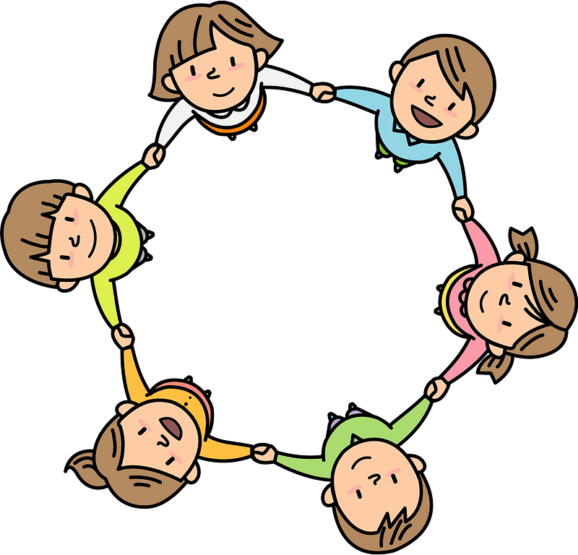


Curriculum Overview Year 5
Advent Term 2024
Please find below information about what your child will be learning this term.
If you would like more information speak to your child’s teacher.
English
Literacy Key Texts to Study:
Wolves in the Walls – Neil Gaiman – Descriptive
The Monsterology Handbook – Ernest Drake – Historical fiction
Cloud Tea Monkeys – Mal Peet and Elspeth Graham – Fiction
Stone Bone Girl – Laurence Anholt - Fiction
Cinquain Poetry – WW1 – Poetry
Guided Reading
Each week we will be reading a range of quality texts including:
Poems: free verse, couplet, word play, nonsense
Fiction: Picture books, adventure, ghost story
Non fiction: Non-chronological report
*Text titles can be obtained from the class teacher.
Maths
Developing fluency in maths:
Place value in numbers up to and beyond 1,000,000
Addition and subtraction of 4 digit numbers
Multiplication and division
Fractions
RE
Domestic Church :Family
Ourselves
• A deepening awareness of ‘Who I am’
• Ourselves as made in the image and likeness of God
Baptism/ Confirmation : Belonging
Life choices
Showing care and commitment
• The call to life and love within the community; marriage
Advent/ Christmas: Loving
Hope
• Waiting hopefully
• Advent is the Church’s season of waiting in joyful hope for the coming of Jesus, the promised One, at Christmas and at the end of time
Science
Mixtures and separation/Properties and changes
Dissolving, sieving, filtering and evaporation.
Properties of materials
Reversible and irreversible changes
Earth and Space
The sun, moon and Earth
Naming and ordering planets
Understanding orbits and rotations, and how these cause seasons, day/night and years.
Art/ Design
DT- Bridges
Art- Designing Jewelry
History/ Geography
Anglo Saxons Settlement of Britain
Key Focus Knowledge – life in Anglo Saxon Britain including village life and the development of Christianity
Key Focus Historical Enquiry – why is most evidence at this time based on Anglo Saxon writing (the winner tells the story)
Europe
Key Geographical Knowledge
Awareness of key locations in Europe and how population is distributed
Key Geographical Enquiry
In depth study of one country to create a profile
PE
GetSet4PE
Tennis - developing forehand groundstroke, backhand groundstroke, volley
Fitness – developing agility, balance, co-ordination, speed.
PSHE
Physical and Mental wellbeing
Families and Friendships
Managing friendships and peer influence
Safe relationships
Physical contact and feeling safe
Respecting ourselves and others
Responding respectfully to a wide range of people
Recognising prejudice and discrimination
Computing
Computer System and Networks
Search accuracy, ranking, promoted results, truth and opinion, copyright
Creating Media
Programming with music
eSafety
Digital footprint
.
Music
Identifying the pitch and rhythm of written notes and experimenting with notating their compositions.

