Slide 1









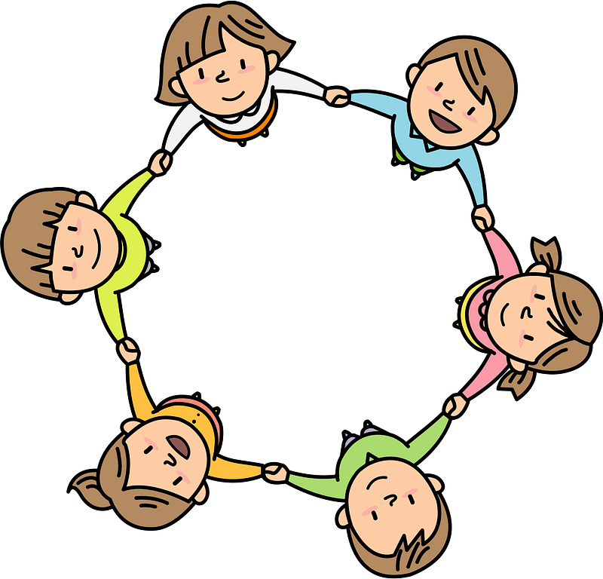


Curriculum Overview Year 5
Advent Term 2026
Please find below information about what your child will be learning this term.
If you would like more information speak to your child’s teacher.
English
Literacy Key Texts to Study:
Cloud Tea Monkeys – Mal Peet and Elspeth Graham – Fiction
Stone Bone Girl – Laurence Anholt – Fiction
The Promise – Ficition
Cinquain Poetry – WW1 – Poetry
Guided Reading
Each week we will be reading a range of quality texts including:
Poems: free verse, couplet, word play, nonsense
Fiction: Picture books, adventure, ghost story
Non fiction: Non-chronological report
*Text titles can be obtained from the class teacher.
Maths
Developing fluency in maths:
Place value in numbers up to and beyond 1,000,000
Addition and subtraction of 4 digit numbers
Multiplication and division
Fractions
RE
Creation and covenant
The Story of Moses
What is a covenant?
The covenants between Moses, Noah, Abraham and David
The Ten Commandments
The most important commandments – To love one another and to love God.
Sin and its impact on our relationship with God
Prophecy and Promise
Scripture telling of the life and importance of David
Great kings who were anointed and chosen in the Old testament
David was called to be a servant king.
Science
Mixtures and separation/Properties and changes
Dissolving, sieving, filtering and evaporation.
Properties of materials
Reversible and irreversible changes
Materials
Properties and changes
PE
GetSet4PE
Tennis - developing forehand groundstroke, backhand groundstroke, volley
Football– developing agility, co-ordination, speed, dribbling, ball handling, endurance .
Art/ Design
DT- Bridges
Art- Designing Jewellery
History
Anglo Saxons Settlement of Britain
Key Focus Knowledge – life in Anglo Saxon Britain including village life and the development of Christianity
Key Focus Historical Enquiry – why is most evidence at this time based on Anglo Saxon writing (the winner tells the story)
Geography
Investigating tourism in mountain environments by learning about the climate and features of the Alps, with a focus on Innsbruck.
PSHE
Physical and Mental wellbeing
Families and Friendships
Managing friendships and peer influence
Safe relationships
Physical contact and feeling safe
Respecting ourselves and others
Responding respectfully to a wide range of people
Recognising prejudice and discrimination
Computing
Computer System and Networks
How search engines work
Creating Media
Programming with music
eSafety
Online protection and communication
.
Music
Identifying the pitch and rhythm of written notes and experimenting with notating their compositions.

