Slide 1
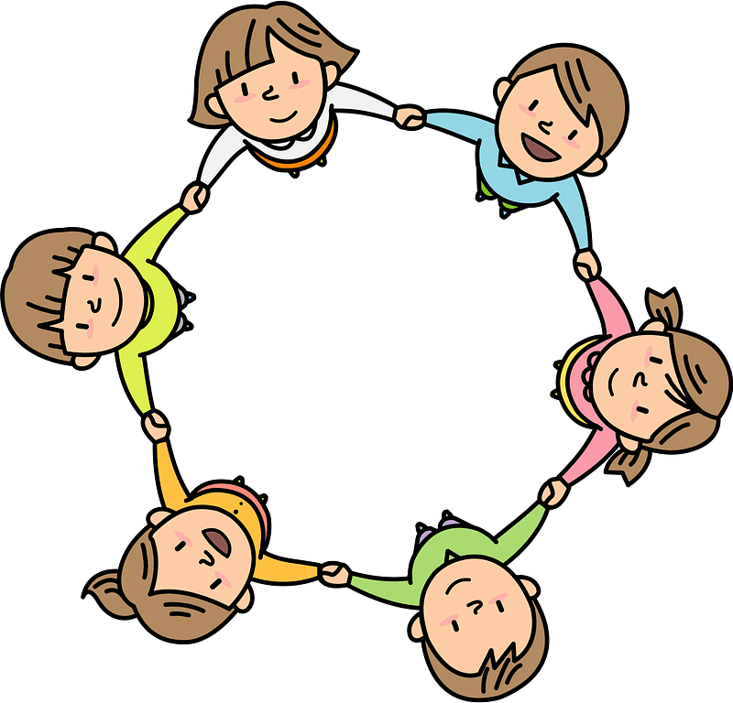
Curriculum Overview Year 4
Advent Term 2023
Please find below information about what your child will be learning this term.
If you would like more information speak to your child’s teacher.
Guided Reading
The Butterfly Lion by Michael Morpurgo
The Firework Makers Daughter by Philip Pullman
Vocabulary
Inference
Summarising
Predicting
Maths
Literacy
Fractions
Journey – Aaron Becker
Herts for Learning: Arthur and the Golden Rope and The King Who Banned the Dark
-Retelling own version of the narrative
-Character description
-Editing and planning
White Rose Maths:
Place value – up to 10,000
Number patterns
Counting in 1000’s and100’s
Addition and subtraction within 10,000
Adding and subtracting with renaming
Mental addition and subtraction
Word Problems
Times tables up to x12
Multiplication and division methods
Electricity
Science
Animals, including humans
(human digestive system, animal and human teeth; food chains)
What do our bodies do with the food we eat?
Living things and their habitats
(observation of living things; classification; impact of human activity on environments)
Are living things in danger?
RE
Domestic church- Family
Our family trees
The family of God in Scripture
Baptism and confirmation
The response to being chosen
Confirmation: a call to witness
Advent and Christmas
The gift of love and friendship
The Church’s seasons of preparing to receive God’s gift of love
Spanish
Body parts and classroom objects
Days of the week
History/ Geography
PE
Art/ Design
Cycladic figures – sculptures
Artists – Henry Moore and Alberto Giacommetti
Histor
Co-ordination – footwork
Physical skills – static balance
Dynamic balance to agility
Jumping and landing
Static seated balance
History – Greeks – how did the Greek Empire influence life today?
Chronology, development of city states, government systems and literature sports and theatre
Geography – Major continents of the world
Locating them on the map
Physical and human characteristics of major countries and major cities
Human settlement
PSHE
Physical health and Mental well
Families and friendships
Positive friendships
Safe relationships
Respecting ourselves and others
Respecting differences and similarities
Computing
Systems – The Internet
-The internet is hardware and World Wide Web its content
-Exploring bias and truth in web content created by people
-Copyright and ownership
-Know where content is stored
Music
Violin
- Music notation, rhythm, technique
Song practice

