Slide 1









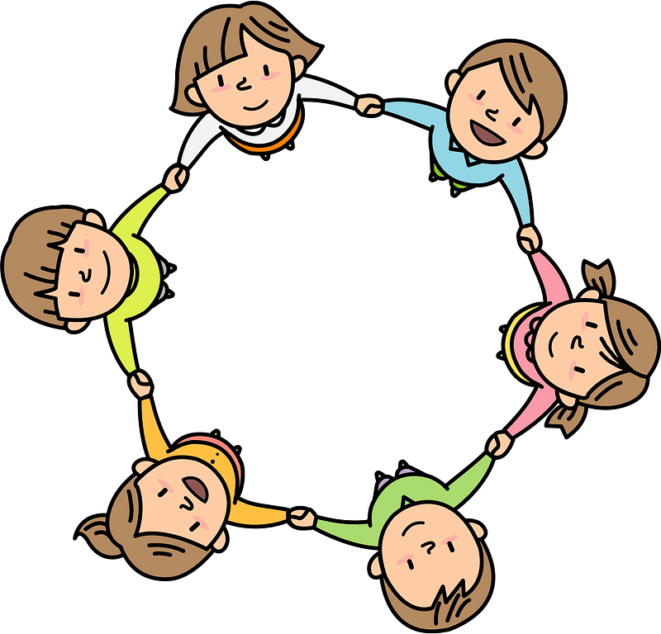


Curriculum Overview Year 4
Pentecost Term 2022 -2023
Please find below information about what your child will be learning this term.
If you would like more information speak to your child’s teacher.
Guided Reading
Varjak Paw - vocabulary, inference, summarising, predicting
Various non-fiction texts to aid with test techniques
Maths
Literacy
Fractions
Biscuit Bear- Mimi Grey
Leon and the Space between – Angela McAllister and Grahame Baker-Smith
The Spider and the Fly by Mary Howitt, illustrated by Tony DiTerlizzi
Instructional writing – How to build and electrical circuit (Science link)
Non-Chronological report based on renewable and non-renewable energy (Science link)
Decimals – writing tenths, hundredths and comparing and ordering and rounding decimals
Measurement - Money
Measurement - Mass, Volume and Length
Geometry – Properties of shapes, positions and movement
Roman Numerals
Multiplication check is this term too.
Electricity
Science
Electricity - Common appliances that use electricity. Construct simple circuits using wires, cells, switches and buzzers.
Recognize common insulators and conductors. How to keep safe
RE
Serving
the wonder and power of the Holy Spirit.
Reconciliation
inter-relating-building the bridges for friendship, the importance of reconciliation
Universal church
world- ordinary people who do extraordinary things, different saints show what Jesus is like.
Spanish
Body parts and classroom objects
Days of the week
History/ Geography
Art/ Design
Artist: John Constable & Georgia O’Keefe
Modern vs traditional landscapes.
Techniques and equipment
Histor
PE
History – local history. Slough Trading Estate during World War 2.
Geography - Agriculture – comparison of agriculture in East Anglia with southern Italy.
Co-ordination – sending and receiving
Physical skills - agility and balance
Basket ball – team building skills
PSHE
Physical health and Mental well
Physical health and Mental wellbeing – maintaining a balanced lifestyle; oral hygiene and dental care
Computing
Control
Efficient programming through repetition/making loops
Digital Media
Combining text, images and sound for a purpose
Music
Violin
Song practice

