Slide 1
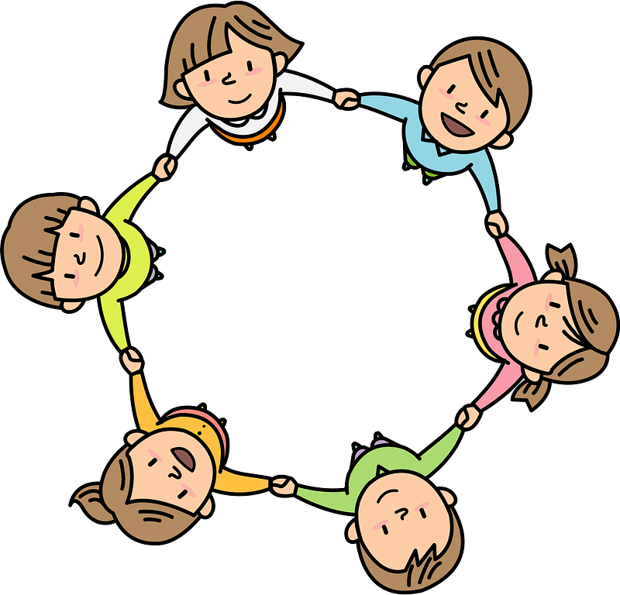
Curriculum Overview Year 4
Lent Term 2021-2022
Please find below information about what your child will be learning this term.
If you would like more information speak to your child’s teacher.
Guided Reading
The Butterfly Lion by Michael Morpurgo
Vocabulary
Inference
Summarising
Predicting
Maths
Literacy
Fractions
Perfectly Norman by Tom Percival
The Unlucky Man- Story Telling schools.
-Retelling own version of the narrative
-Character description
-Editing and planning
Consolidating Mastery and use of Number Talk
Number: Multiplication and division
Word problems
Fractions
Times tables up to x12
Electricity
Science
Classifying living things
Food chains
vertebrates and invertebrates
RE
Domestic church- Family
Jesus’ family
Abrahams family
Story of Ruth
Baptism and confirmation- Belonging
Advent and Christmas- Loving
Spanish
Body parts and classroom objects
Days of the week
History/ Geography
Art/ Design
Cycladic figures – sculptures
Artists – Henry Moore and Alberto Giacommetti
Histor
PE
History – Greeks – how did the Greek Empire influence life today?
Chronology, development of city states, government systems and literature sports and theatre
Geography – Major continents of the world
Locating them on the map
Physical and human characteristics of major countries and major cities
Human settlement
Co-ordination – footwork
Physical skills – static balance
Dynamic balance to agility
Jumping and landing
Static seated balance
PSHE
Physical health and Mental well
Computing
Programming
– Using repeat loops
Decompose (identify the parts of something) to create line and shapes patterns
– Databases
Questions to sort objects in a . . branching database
Families and friendships
Positive friendships
Safe relationships
Respecting ourselves and others
Respecting differences and similarities
Music
Violin
Song practice

