Slide 1
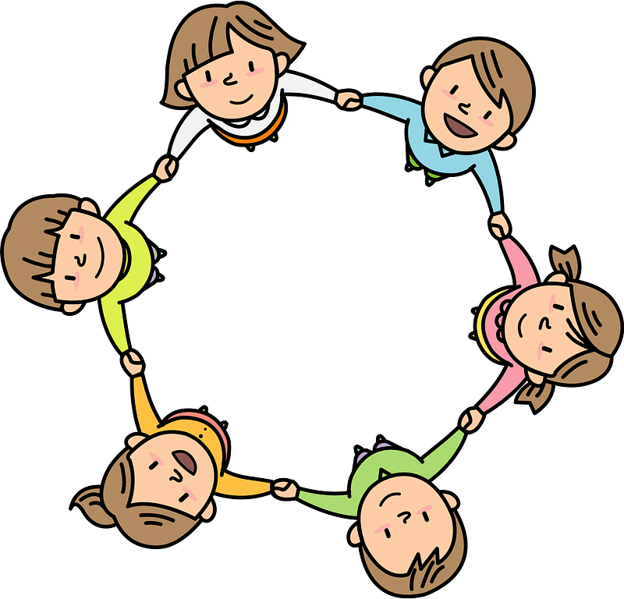
Curriculum Overview Year 3
Advent Term 2023
Please find below information about what your child will be learning this term.
If you would like more information speak to your child’s teacher.
Literacy
Key Texts to Study:
Journey – Whole school book
Paperbag Princess – Herts for Learning
Stone Age Boy – Story Telling Schools
Walk with a Wolf - Herts for Learning
Guided Reading
Iron Man – Chapter Book
The Sound Collector – Poem
Stig of the Dump – Chapter book
Types of writing
Narrative: recounting an adventure story
Non fiction: writing a non chronological report & instructions
Poetry: writing a nonsense poem
Maths (White Rose Maths scheme)
Number and place value: recognising and writing numbers to 1000
Calculation: adding and subtracting up to 3 digit numbers, multiplying and dividing up to 3 digit numbers and using these skills to complete long multiplication and division questions.
Mental arithmetic: 3, 4 and 6 Times tables
RE
Homes (to know and understand):
• The joys and sorrows of being a family at home
• God’s vision for every family
Prior learning - God is present in every beginning
Promises (to know and understand):
Belonging to a group involves promises and rules
The meaning of the promises made at Baptism
Prior learning - signs and symbols used in Baptism
Visitors (to know and understand):
• The demands and joys of visitors
• Advent: waiting for the coming of Jesus
Prior learning - Advent: four weeks of preparation for the celebration of the birth of Jesus at Christmas
Science
Animals, including humans
(Bones; healthy eating)
Do all animals need a skeleton?
Light
(sources of light; shadows; opaque and translucent)
What can you see when there is no light?
Art/ Design
Key artist: Durer
Key skills: Using charcoal and pastel to draw texture
History/ Geography
Topic: The Stone Age to The Iron Age
Key Knowledge – Looking at how the development of new tools and weapons led to changes in the way that people lived; from nomads to farmers
Key Historical Enquiry – How our knowledge of early man is based on archaeology
PE
Get Active:
Athletics, Handball
Real PE:
Coordination; floor movement patterns
Balance and agility; static balance skills up to one leg standing
PSHE
Families and Friendships
What makes a family
Features of family life
Safe relationships
Personal boundaries
Safely responding to others
The impact of hurtful behaviour
Respecting ourselves and others
Recognising respectful behaviour
The importance of self-respect
Courtesy and being polite
Computing
Networks - Connecting Computers
Classify inputs, processing and outputs in computers and toys containing computers
Explore and describe the roles of a server, switch and wireless access point
Recognize benefits ot safe networking
Music
Rhythm and pulse through drumming.
Key piece: Symphony No. 1 in G major – Allegro by Saint-Georges

