Slide 1










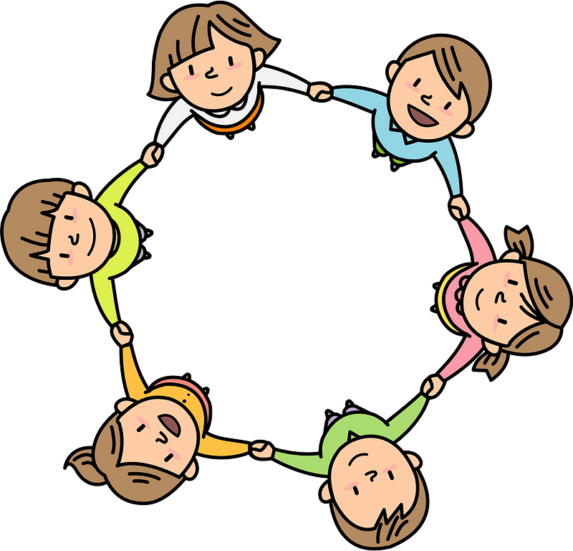

Curriculum Overview Year 3
Advent Term 2025
Please find below information about what your child will be learning this term.
If you would like more information speak to your child’s teacher.
English
Key Texts to Study:
Mini Rabbit Not Lost – Herts for Learning
Walk with a Wolf - Herts for Learning
Types of writing
Narrative: recounting an adventure story
Non-fiction: writing a non-chronological report & instructions
Poetry: writing a nonsense poem
Guided Reading
Each week we will be reading a range of texts including:
Poems: list, free verse and narrative
Fiction: Short stories and adventure/ historical
Non fiction: Non-chronological reports, reference
Maths (White Rose Maths scheme)
Number and place value: recognising, partitioning and writing numbers to 1000
Calculation: adding and subtracting up to 3-digit numbers, recall and use times tables and related division facts for 2, 3, 4, 5, 8, and 10 fluently and multiply and divide 2-digit numbers by 1-digit numbers.
Mental arithmetic: 2, 3, 4, 5, 8 and 10 Times Tables
RE
Creation and covenant
The symbolism in the Creation story
The relationship between God and humans
That in the account of Genesis, one day is 'made holy'
That the Church teaches that Creation is the work of the Holy Trinity
Prophecy and promise
Why do Christians go to Mass?
How Catholics celebrate Mass
The prophecy of the Messiah
Science
Movement and Nutrition
Human Skeleton, muscles and joints, how the body uses energy, understanding a balanced diet.
Forces and Magnets
Investigating motion, friction, contact and non-contact forces, different magnets and their uses.
Art/ Design
Key artist: Durer Key skills: Using charcoal, chalk and pencil to create texture
DT - Creating Structures linked to castles
History/ Geography
Topic: The Stone Age to The Iron Age
Key Knowledge – Looking at how the development of new tools and weapons led to changes in the way that people lived; from nomads to farmers
Key Historical Enquiry – How our knowledge of early man is based on archaeology
PE
Fundamentals – developing running dodging, hopping and skipping
Fitness – developing balance, running, communication and co-operation
PSHE
Families and Friendships
What makes a family
Features of family life
Safe relationships
Personal boundaries
Safely responding to others
The impact of hurtful behaviour
Respecting ourselves and others
Recognising respectful behaviour
The importance of self-respect
Courtesy and being polite
Computing
Networks – Connected devices
Explore how server, switch and wireless access point connect
How packets of data convey information
eSafety – about posting online
Programming – scratch
Systematic working in remixed scratch projects
Music
Learning the features of ballads and performing them.
Weekly drumming lessons on Wednesdays.

