Slide 1









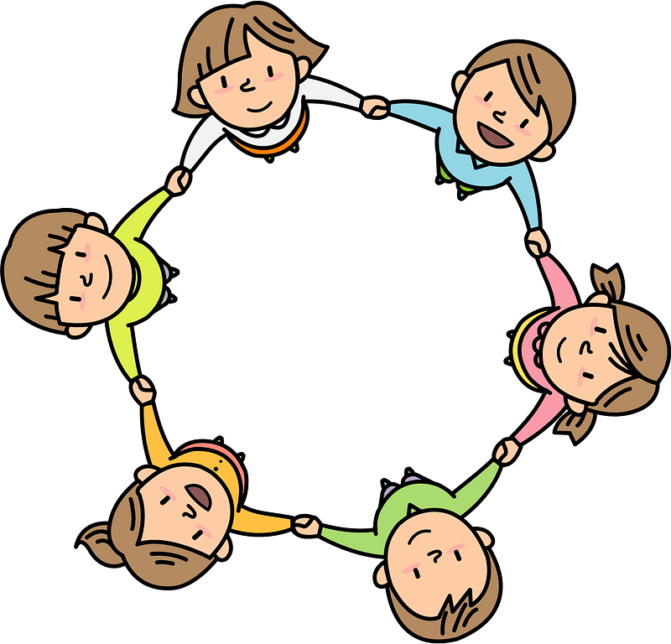


Curriculum Overview Year 2
Advent Term 2025
Please find below information about what your child will be learning this term.
If you would like more information speak to your child’s teacher.
Writing
Read, Write Inc Phonics
All pupils will continue reading, writing and spelling using the RWI phonics scheme.
Set 1, 2 and 3 sounds plus additional sounds
Speed reading
Reading for fluency
Holding a sentence to build writing stamina
Spellings
Once pupils complete the scheme up to the blue band of reading, they will move onto Guided Reading and whole class Literacy sessions. This should be most children by January.
Maths – White Rose Maths Scheme
- Place Value
- Numbers to 100
- Counting in 2s, 5s, 10s and 3s
Addition and Subtraction
Add and subtract across 10
Add 2-digit numbers
Subtract 2-digit numbers
Shape
Recognise 2D and 3D shapes
Count sides, vertices, faces and edges
Lines of symmetry
RE
Creation and covenant
The story of Noah
God's covenant with Noah
Baptism is a sacrament and that being baptised means you become a member of the Christian family.
The Bible is split into two parts; the Old Testament and The New Testament.
Prophecy and promise
The Annunication of John the Baptist
The Annunciation of Jesus
Science
Topic - Habitats
To know a variety of plants and animals and describe differences.
To know that a habitat is the environment where an animal or plant lives/grows, because it provides what they need to survive.
To know that a micro-habitat is a very small habitat
To know that living things depend upon each other (e.g. for food,
shelter.)
Art/ Design
Great fire of London – contemporary artists
History/ Geography
History – Great fire of London – What were the causes and effects of the fire?
How reliable are first hand evidence and contemporary accounts?
Key figure – Samuel Pepys
Geography – Would you prefer to live in a hot or cold country. Introducing continents, North and South poles and climate zones and weather
GetSet4PE
Fundamentals – developing agility, speed and balance. Collaboration, respect and turn taking
Fitness - stamina, skip, co-ordination, agility, strength, balance
PSHE
Physical and Mental wellbeing
Relationships
Families and friendships
Making friends, feeling lonely and getting help.
Safe relationships
Resisting pressure and getting help, and recognising hurtful behaviour
Respecting ourselves and others
Recognising things in common and differences, playing and working cooperatively and sharing opinions.
Computing
What is a computer?
Where are computers
Input and output
Instructions as algorithms
Word processing
What does online mean?
Music
Chanting different call and response sound patterns, creating their own call and response patterns using percussion instruments.

