Slide 1









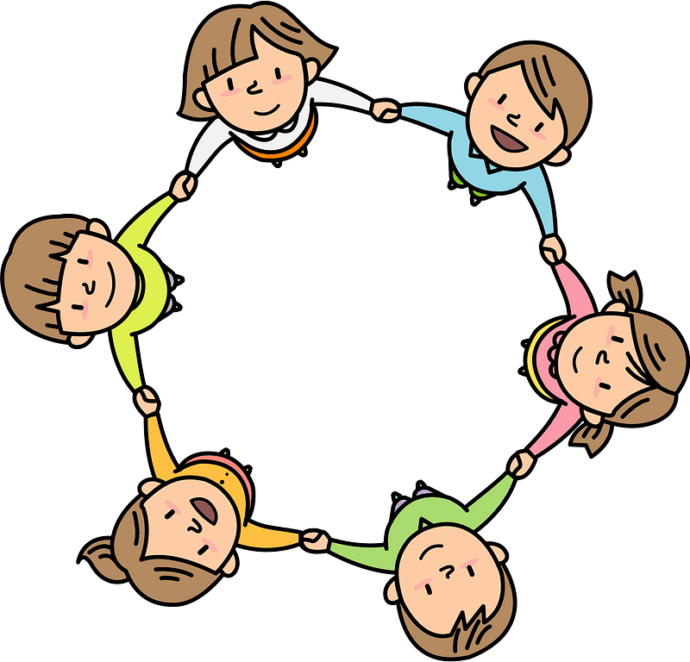


Curriculum Overview Year 2
Advent Term 2024
Please find below information about what your child will be learning this term.
If you would like more information speak to your child’s teacher.
Writing
Read, Write Inc Phonics
All pupils will continue reading, writing and spelling using the RWI phonics scheme.
Set 1, 2 and 3 sounds plus additional sounds
Speed reading
Reading for fluency
Holding a sentence to build writing stamina
Spellings
Once pupils complete the scheme up to the blue band of reading they will move onto Guided Reading and whole class Literacy sessions. This should be most children by January.
Maths – White Rose Maths Scheme
Place Value
- Numbers to 100
- Counting in 2s, 5s, 10s and 3s
Addition and Subtraction
Add and subtract across 10
Add 2 digit numbers
Subtract 2 digit numbers
Shape
Recognise 2D and 3D shapes
Count sides, vertices, faces and edges
Lines of symmetry
RE
Beginnings
The many beginnings each day offers
God is present in every beginning
Baptism
• Experience of signs and symbols
• Signs and symbols used in Baptism
Advent/Christmas
Preparing for special times
Four weeks of preparation for the celebration of Jesus at Christmas
Science
Topic - Habitats
To know a variety of plants and animals and describe differences.
To know that a habitat is the environment where an animal or plant lives/grows, because it provides what they need to survive.
To know that a micro-habitat is a very small habitat
To know that living things depend upon each other (e.g. for food,
shelter.)
Art/ Design
Great fire of London – contemporary artists
History/ Geography
History – Great fire of London – What were the causes and effects of the fire?
How reliable are first hand evidence and contemporary accounts?
Key figure – Samuel Pepys
Geography – Where we come from? – Mapping the world.
To find out what migration is and its impact on the UK.
GetSet4PE
Fundamentals – developing agility, speed and balance. Collaboration, respect and turn taking
Fitness - stamina, skip, co-ordination, agility, strength, balance
PSHE
Physical and Mental wellbeing
Relationships
Families and friendships
Making friends, feeling lonely and getting help.
Safe relationships
Resisting pressure and getting help, and recognising hurtful behaviour
Respecting ourselves and others
Recognising things in common and differences, playing and working cooperatively and sharing opinions.
Computing
What is a computer?
Parts of a computer
Types of computer
Input and output
Instructions as algorithms
Music
Chanting different call and response sound patterns, creating their own call and response patterns using percussion instruments.

