Slide 1
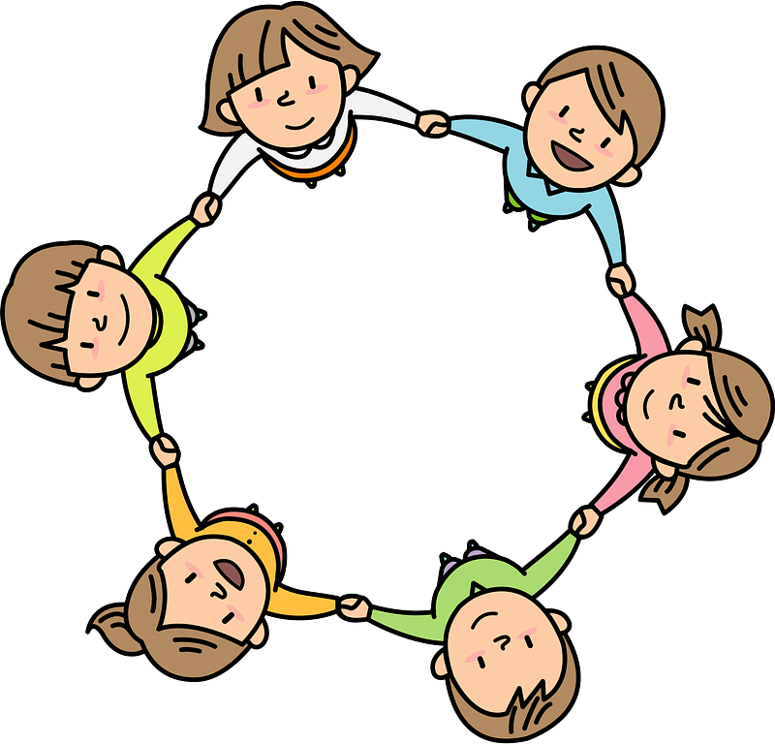
Curriculum Overview Year 2
Pentecost Term 2021-2022
Please find below information about what your child will be learning this term.
If you would like more information speak to your child’s teacher.
Literacy
Key Texts to Study:
Castles- Nonfiction text
Tuesday- Wordless picture book
3 Wishes- Storytelling Schools fiction text
Image Shed- Creative writing stimulus
Sick- Poem
Types of writing
Narrative- Traditional Tale, adventure
Nonfiction- No chronological report & recount
Maths
Consolidating Mastery and use of Number Talk
Telling the time – O'clock, half past, quarter past and quarter to. 5 minute intervals and word problems
Statistics – pictograms, tally charts, tables.
Money
Shapes:
2D
3D
Symmetry
Measurement:
Length
Mass
Temperature
RE
Spread the word:
• Passing on messages
• Pentecost, spreading the Gospel message through the gift of the Holy Spirit
Acquire the skills of assimilation celebration and application of the above
Rules:
• How rules can help at home and in school
• The reasons for rules in the Christian family
At the end of the topic know and understand how to celebrate what they have learnt and link this with previous learning.
Treasures:
• What we treasure
• The world is God’s treasure given to us
Acquire the skills of assimilation celebration and application of the above
Science
Plants
Seeds and bulbs grow into plants. What a plant needs to grow and stay healthy.
What do plants need to survive?
Uses of everyday materials
Suitability of a variety of materials for particular uses.
Materials can be changed – squashing, bending, twisting and stretching.
How do we choose materials?
Art/ Design
Study of Alfred Wallace
Who was he?
What is unusual about his paintings?
Painting the sea in different, -moods – colour and texture
History/ Geography
Local area comparisons – our local area compared to a non-European country
Understand geographical similarities through studying the human and physical geography of our town and non-European country,
Local history unit – Windsor castle
Understanding features of a castle, what are they used for? How use has changed (then & now)
How our knowledge of the past is developed through the use of sources.
PE
Ball skills:
Hitting
Catching
Throwing
Gymnastics
Developing coordination and balance
PSHE
Physical and Mental wellbeing
Why sleep is important
Medicines and keeping healthy
Keeping teeth healthy
Managing feelings and asking for help
Growing and changing
Growing older
Naming body parts
Moving class or year
Keeping safe
Safety in different environments
Risk and safety at home
Emergencies
Computing
Digital Painting
Combining shaped tools
Digital Writing
Capital letters, full stops
and colours
Music
Glockenspiels stage one. Listen, respond and create music on the Glockenspiels.

