Slide 1
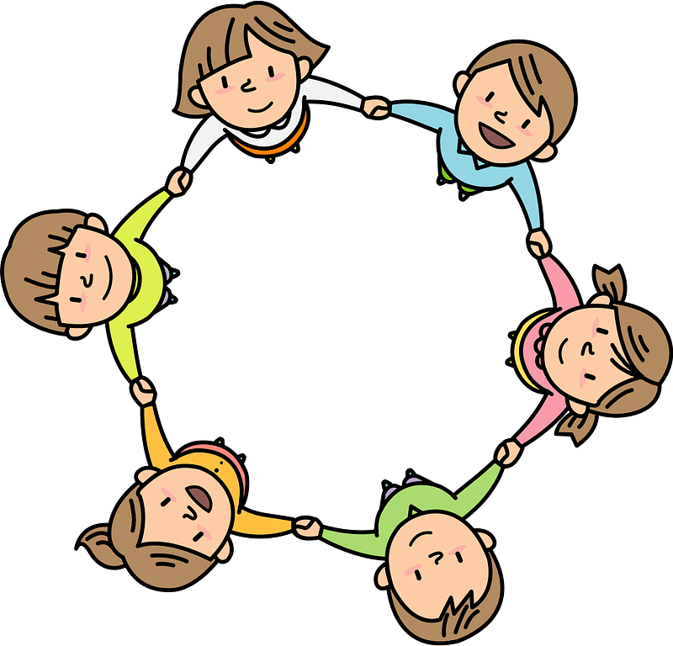
Curriculum Overview Year 1
Pentecost Term 2021-2022
Please find below information about what your child will be learning this term.
If you would like more information speak to your child’s teacher.
Literacy
Guided Reading Key text
Beegu – Alexis Deacon
Knuffle Bunny- Mo Willems
Lost and Found – Oliver Jeffers
Skinny Old lady – Storytelling schools
Flora and the Penguin - Wordless book
Types of Writing
Narrative: recounting an adventure story
Non-Fiction: diary entry
Non-Fiction: Non- chronological report
Maths
Consolidating Mastery and use of Number Talk
Multiplication and Division- One step word problems
Measurement – capacity and mass
Fractions- halves and quarters of a shape and quantity
Position and Direction
RE
Holidays and Holydays
Holidays as days to be happy
Pentecost; a holy day – the feast of the Holy Spirit
Being sorry
We have choice – sometimes we choose well, and sometimes wrongly
God helps us to choose well and to be sorry. God forgives us
Neighbours
Neighbours all around
Everyone is our neighbour and is loved by God
Science
Everyday Materials
Name the object and what it is made from. Identify and name a variety of materials – wood, plastic, glass, metal, water and rock. Compare materials.
What are things made from?
PE
Coordination with Equipment
Agility – Reaction/Response
Agility – Ball Chasing
Static Balance – Floor Work
Art/ Design
Artist: Roald Bradstock
Skills
Drawing and painting from life and photographs
Graphic design and colour
Physical health and Mental wellbeing
Growing and changing
Keeping safe
History/ Geography
The London Olympics -1908, 1948, 2012
A significant event identifying in what ways the three London Olympics were similar and different.
The British Isles
Name and locate and identify characteristics of the four countries and capital cities of the United Kingdom and its surrounding seas
Countries in the British Isles v the UK .
PSHE
Computing
Control
Sequence (Beebots and 2Go in PurpleMash
Programming
Simple sequence debugging
Music
Yolanda Brown lessons, pitch, rhythm. Creating own musical instruments.

