Slide 1
Supporting your Child’s Well-Being
Parent Workshop 14th June 2022

Slide 2
Key points to supporting your child’s well-being
Good mental health helps children develop socially, emotionally, mentally and physically.
Loving relationships are key to children’s mental health.
Learning to manage feelings is important to mental health.
Physical activity, healthy eating habits and sleep are good for children’s mental health.

Slide 3
What is Mental Health?
Mental health is the way children think and feel about themselves and the world around them. It affects how children cope with life’s challenges and stresses.
What good mental health in children looks like:
Children with good mental health:
feel happy and positive about themselves most of the time
are kind to themselves during tough times or when things don’t go the way they expect
enjoy life
learn well
get along well with family and friends
can manage sad, worrying or angry feelings
can bounce back from tough times
are prepared to try new or challenging things.

Slide 4
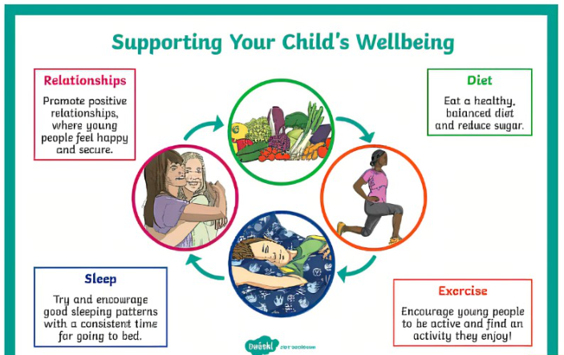

Slide 5
Relationships and good mental health for children
A positive relationship with you directly and positively affects your child’s mental health.
Tell your child that you love them, no matter what. You can also show love through your body language
Use a positive, constructive and consistent approach to guide your child’s behaviour.
Make time every day to talk and listen to your child.
Enjoy time with your child doing activities they like.
Work on positive ways to solve problems and manage conflict between you and your partner,
with your child and among other family members.
Encourage your child to connect with others in the community

Slide 6
Emotions and good mental health for children
Children experience all sorts of emotions as part of growing up – fear, disappointment, sadness, anxiety, anger, joy, hope and so on. When children cope with big emotions or calm themselves down in difficult or emotional situations, they’re likely to feel good about themselves.
Talk about emotions with your child, and encourage them to recognise and label their emotions.
Role-model a positive outlook for your child – for example, ‘I’m disappointed that my cake didn’t cook properly, but that’s OK – I’ll try it again another time’.
Support your child when something is bothering them.
Help your child learn to manage small worries so they don’t become big problems.

Slide 7
Good physical health for children- Exercise:
Good physical health is important for mental health. That’s because being active helps your child stay healthy, have more energy, feel confident, manage stress and sleep well.
Encourage your child to try plenty of different physical activities and sports.
Sign your child up for one of our after school clubs- they can learn a new sport whilst being active and making new friends
Try a new activity at home together- dance to your favourite song in the kitchen, try yoga ( Cosmic Yoga is great on youtube), go for a long walk to the park, join a Park Run on a Saturday or go for a cycle together….

Slide 8
Diet
Offer healthy food and encourage healthy eating habits in your family.
What goes into a healthy packed lunch?
Bread, cereals, potatoes and other starchy foods
Examples: sandwiches, pitta bread, wraps, pasta salad, potato salad, potato or sweet potato wedges, rice dishes, couscous, bread sticks, crackers, rice cakes, plain popcorn.
Fruits and vegetables
Examples: fresh fruit, tinned fruits, dried fruits, salad items, any type of vegetables. You could include vegetable sticks for dipping or add veggies to salads, pasta or rice or couscous dishes.
Dairy and dairy alternatives
Examples: cheese, yoghurts (or dairy-free alternative e.g. soya yoghurts), custard (soya custard), rice pudding, a carton of milk or yoghurt-based smoothies, carton of milk or a dairy-free alternative such as soya, oat milk or coconut milk.
Meat, fish, eggs, beans and other non-dairy sources of protein
Examples: chicken, turkey, pork, beef, lamb, beans, fish, shellfish, lentils, chickpeas, pulses, hummus, quorn or soya products such as tofu.

Slide 9
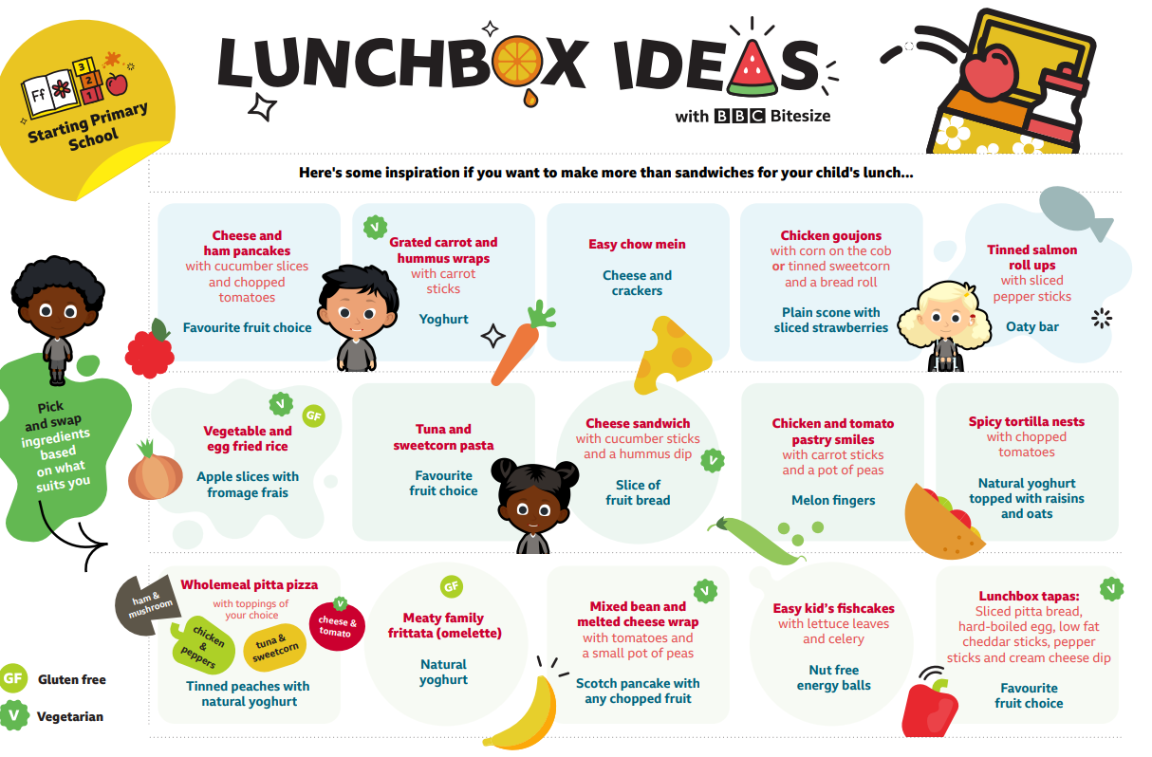
Drinks
Milk and water are the best drinks for children because they are tooth-friendly.
Our school does NOT allow sugar-sweetened soft drinks and fizzy drinks because they cause tooth decay.

Slide 10
Sleep
Make sure your child gets the sleep they need. Quality sleep will help your child to manage stress and a busy life. Sleep is also important for their growth.
Bedtime Routine Sticking to a set pattern each night will help your child to settle before bed and give them the time to calm down before sleeping. Going to the toilet as the last task before getting into bed can also help prevent your child from needing to get up in the night time.
Your child’s sleeping environment should be a place where they feel safe and secure,
but should also be a place to sleep and not play.
Start quiet time about one hour before your child goes to sleep, by tidying away toys and screens.
• Run your child a bath and keep to a ten minute time limit.
Read them a bedtime story to relax them.

Slide 11
The American Academy of Sleep Medicine in 2016 recommended the right amount of
sleep for children and young people. The table below gives an indication of the amount
of sleep your child needs on a regular basis to keep them healthy.
Your child’s age | Recommended sleep time in 24 hours
Infants 4 to 12 months | 12 to 16 hours including naps
Children 1 to 2 years | 11 to 14 hours including naps
Children 3 to 5 years | 10 to 13 hours including naps
Children 6 to 12 years | 9 to 12 hours
Teenagers 13 to 18 years | 8 to 10 hours

