Slide 1
Reading Coffee Morning
October 2023

Slide 3
Early Reading

Slide 4
Children learn sounds in a set order according to our Read Write Inc phonics scheme

Slide 20
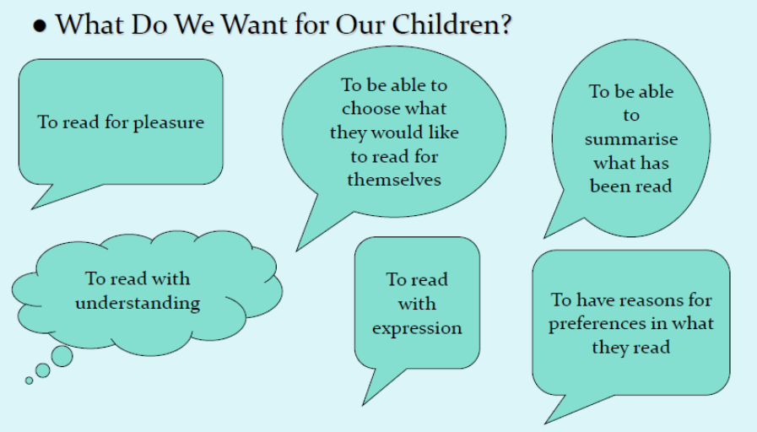

Slide 24
Thank you so much
for listening.
Any questions?

