Slide 1
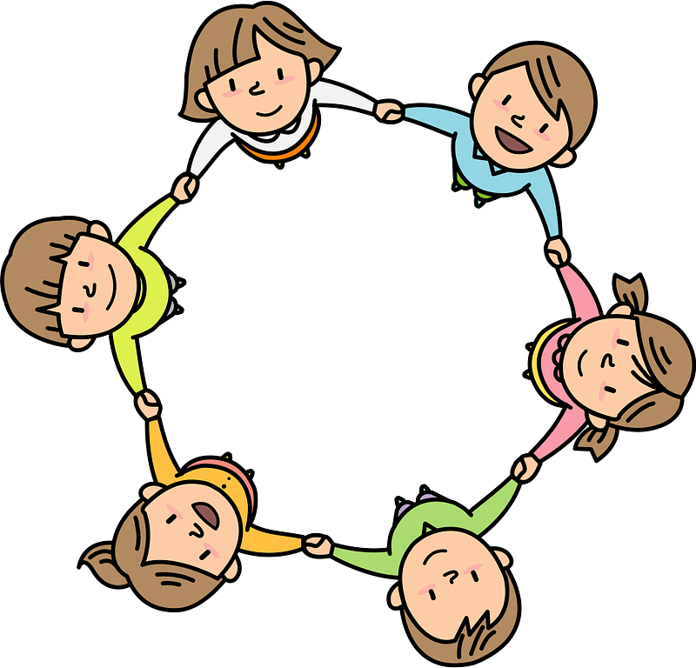
Curriculum Overview Year 3
Pentecost Term 2021-2022
Please find below information about what your child will be learning this term.
If you would like more information speak to your child’s teacher.
Literacy
Key Texts to Study:
The Tear Thief – Picture book
The Sound Collector – Poem
The Magic Faraway Tree – Fantasy Fiction
The Wooden Horse – Storytelling schools
Dracula’s Whitby – Video stimulus
Types of writing:
Character description
Narrative poem
Historical innovation
Horror build up
Maths
Consolidating Mastery and use of Number Talk
Statistics
Pictographs and bar graphs
Geometry
Properties of shapes, angles and lines
Measurement:
Perimeter of Figures
Review: Timetables and division facts
RE
Energy:
• The energy of fire and wind
The wonder and power of the Holy Spirit
how to celebrate what they have learnt and link this with previous learning.
Choices:
• Choices have consequences
• The importance of conscience in making choices
Acquire the skills of assimilation celebration
Special places:
• Everyone has a special place
• Special places for Jesus and the Christian community
Acquire the skills of assimilation, celebration and application of the above
Science
Light
How are shadows formed?
recognise that shadows are formed when the light from a light source is blocked by a solid object.
find patterns in the way that the sizes of shadows change.
Animals, including humans
Why is it important to eat the right foods?
Eating is for nutrition
Skeletons and muscles are for support, protection and movement.
PE
Get active:
Gym, cricket/Tennis
Real PE:
Cardio and Agility: Reaction/ Response
Cool Down and balance:
Cardio and Agility: Ball Chasing
Cool Down and balance:
Art/ Design
Artist study: Chris Ofali
History/ Geography
Local history- Hershel park
How did Herschel Park get its name? Using sources to craft a narrative spanning two hundred years.
Climate and Weather
Use research and enquiry to find out about changes to the climate zones of the world
PSHE
Physical health and Mental wellbeing: Healthy choices and habits, What affects feelings, Expressing feelings
Growing and changing
Personal strengths and achievements, Managing and reframing setbacks
Keeping safe
Risks and hazards, Safety in the local environment and unfamiliar places
Computing
Animation:
Combining words and pictures:
Programming:
Events
Sound
Music
Rhythm and pulse through drumming. We will also be learning how music has changed over time.

