Slide 1
Online Safety for children and families
05th June 2022

Slide 2
The internet is a brilliant platform for children to learn and have fun and within our learning at St Ethelbert’s, we encourage the children to use it regularly and build upon their skills.
Technology has become such a normal part of day-to-day life however making sure your child has a healthy balance between the online and real worlds can be difficult.
There are risks online, just like in the real world, therefore it is important to understand what children are doing online so that you can guide them. Taking risks is a normal part of growing up, but in the online world this can have long-term affects. It’s important to create a balance between allowing your child to experiment and develop their independence, and making sure they are aware of what can go wrong and how to deal with it.

Slide 3
Staying Safe Online
Don’t post any personal information online – like your address, email address, school or mobile number.
Think carefully before posting pictures or videos. Once you’ve put a picture online most people can see it and may be able to download it, it’s not just yours anymore.
Keep your privacy settings on the computer as high as possible.
Never give out your passwords.
Don’t make friends with people you don’t know.
Don’t meet up with people you’ve met online. Speak to your parent or carer about people suggesting you do.
Remember that not everyone online is who they say they are.
Think carefully about what you say before you post something online.
Respect other people’s views, even if you don’t agree with someone else’s views doesn’t mean you need to be rude.
If you see something online that makes you feel uncomfortable, unsafe or worried: leave the website, turn off your computer if you want to and tell a trusted adult immediately.

Slide 4
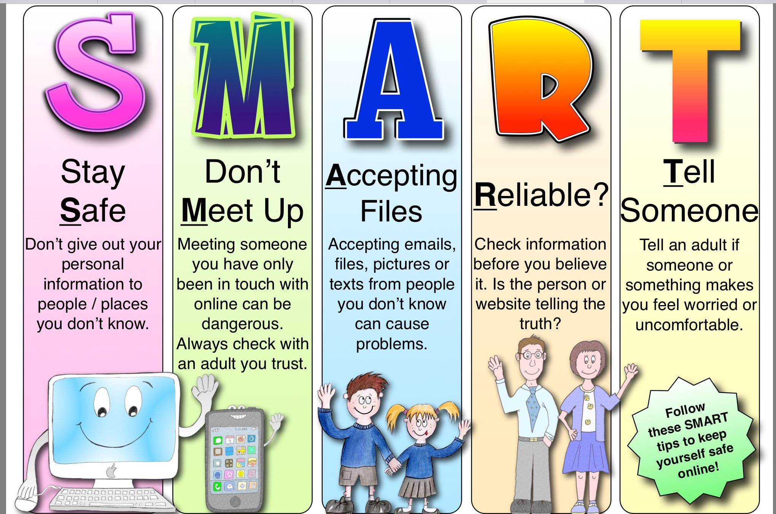

Slide 5
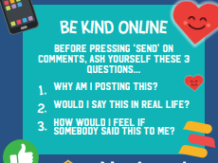
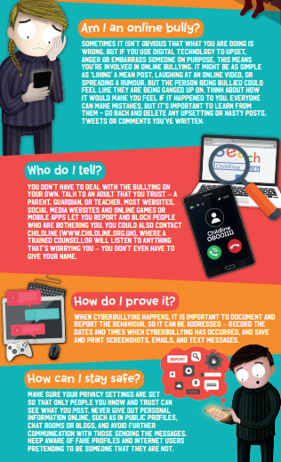

Slide 6
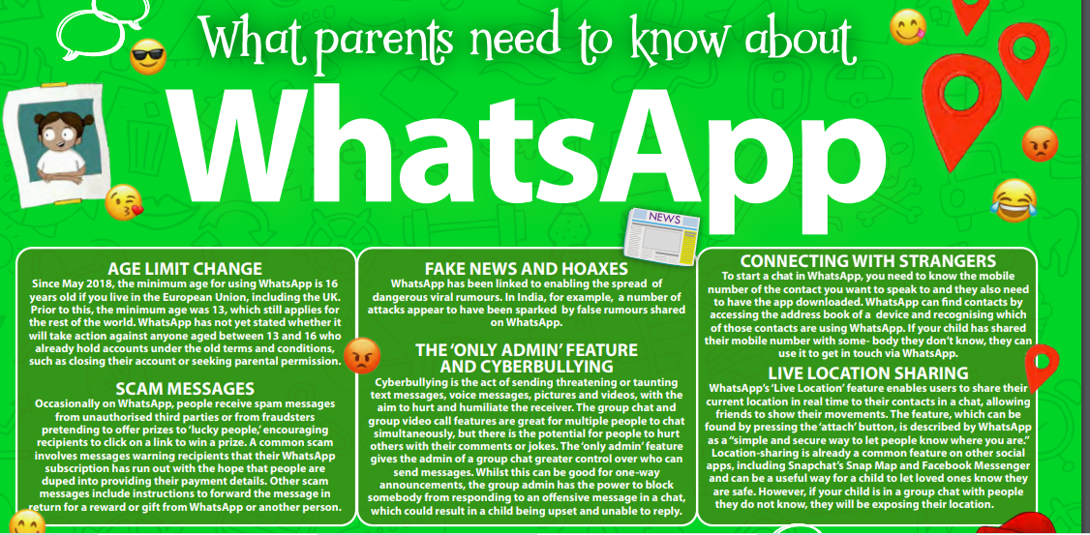

Slide 7
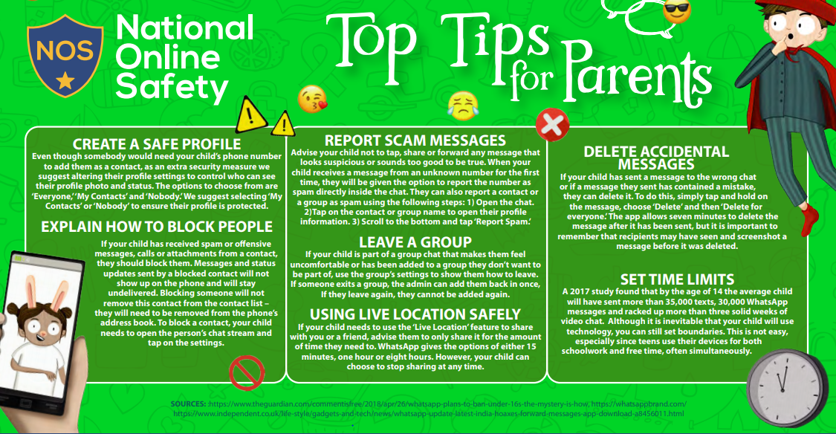

Slide 8
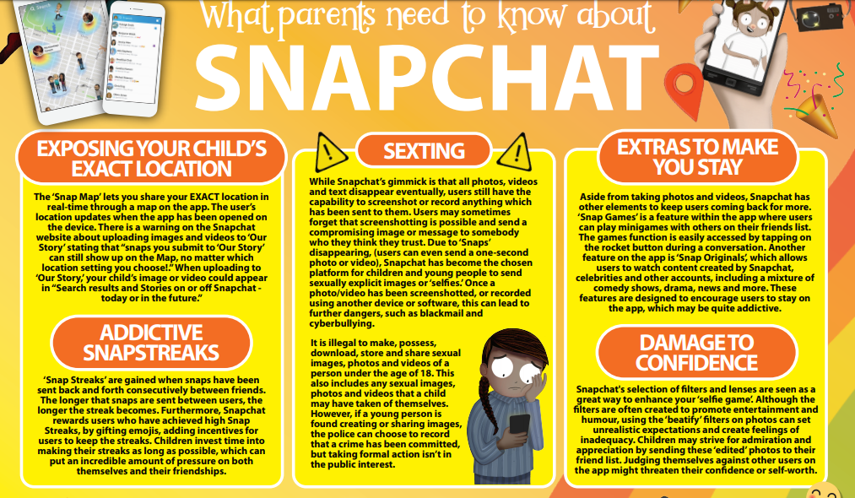

Slide 10
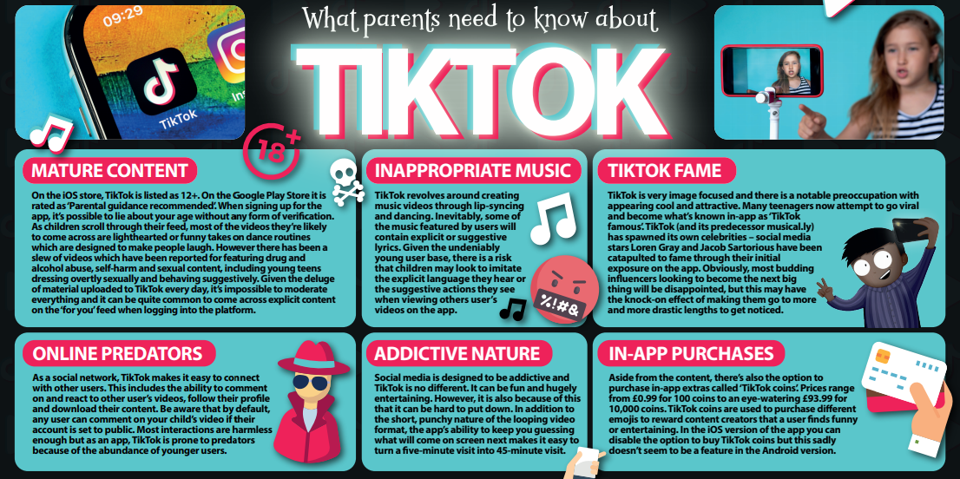

Slide 11
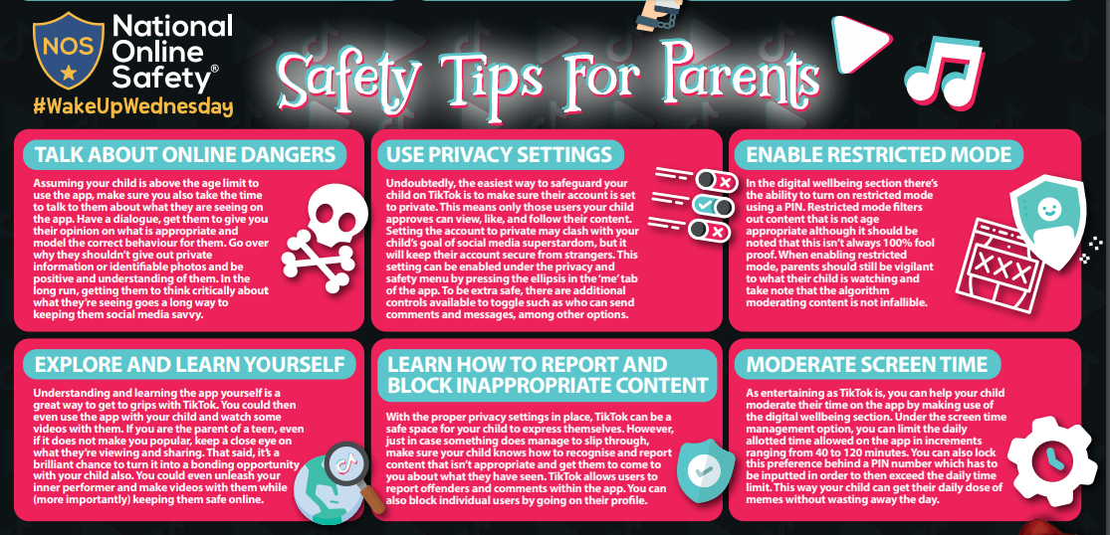

Slide 12
Go private:
Head into Settings > Privacy and Safety and look for the Discoverability heading at the top.
Under that you'll see a setting called Private Account. Toggle this on.
TikTok recommends your page to lots of other users to improve video circulation.
Switch the setting off and the account will no longer be recommended to other users.
Shut out unknown people:
In Privacy and Safety > Safety, you can prevent other users from interacting with you.
Most of the settings are on Everyone by default, but can be changed to Friends or Off.
You can prevent interactions on comments, Duets, Reacts, users seeing which videos you've liked,
and also messages.
Restricted Mode ON:
Restricted Mode tries to limit age-inappropriate content from appearing for children. It's not perfect, and works through using computer-scanning systems – so some content will inevitably be missed.
It's also possible to set a passcode to prevent your child from changing this setting later on.
You'll find this in Settings > Digital Wellbeing > Screen Time Management.
Family Safety Mode:
This setting lets you assign accounts as 'Parent' or 'Teen', giving you remote control over a child's TikTok access. You can set watch time limits, exclude inappropriate content and limit who can send messages. It's possible to do this from your own smartphone, so you can make sure your child is as protected as possible from anywhere.
This setting is in Settings > Digital Wellbeing > Family Safe Mode.

Slide 13
Talk about how they can stay safe on social networks
Ask your child if they know:
• Where reporting functions are
• How to block someone
• How to keep information private.
Show them how to do these things. Use Net Aware to help you.
Talk about online privacy, and being Share Aware. Explain that online behaviour – including sharing personal information – should mirror behaviour in person.
Explain that talking to strangers isn't always 'bad', but they should always be careful about what they share and sometimes people aren't who they say they are.

Slide 14
Ask about things they might see online which make them feel uncomfortable
Talk about things they or their friends, have seen that may have made them feel uncomfortable
Be specific. What exactly made them feel uncomfortable and why? Is it people or animals being hurt? Nasty comments about others?
Link these to things in the real world, and explain that you're always here to protect and help them online and off.
Reassure your child that they can always talk to you about anything that makes them feel uncomfortable.
Show them how to report or block on the sites and apps they use. Use Net Aware to find out how.
Tell them you'll help them to report anything upsetting they've seen, or to deal with online bullying.

Slide 15
Reassure them that you won't overreact – you're just looking out for them
Explain that you understand the internet is a great place to be and that you're just looking out for them.
Tell them they should speak up and not keep secrets if something is worrying them.
Reassure them that you're interested in all aspects of their life. Say that you'd like to talk about stuff they've seen online, sites and apps they visit, and that you'll share the things you've seen too. Recognise that they'll be using the internet to research homework, for example.
Talk to your child about what 'personal information' is - such as email address, full name, phone number, address and school name - and why it's important.
Explain simple ways to protect privacy. For example, avoiding usernames like birthdates or locations that give away too much information.
Discuss images and photos, and what might be appropriate. Help your child understand how photographs can give people a sense of your personality, and that sharing the wrong kind of image can give the wrong impression.
Explain that it isn't easy to identify someone online. People aren't always who they say they are, so don't share personal information. If it's someone who genuinely knows your child, they shouldn't need to ask for personal information online.
Tell your child that if they're in any doubt they should talk to you first.

Slide 16
Explore sites and Apps together
Explore sites and apps together.
Talk about what might be OK for children of different ages. Ask your child what sites or apps they like. Write a list, and look at them together.
Be positive about what you see, but also be open about concerns you have: "I think this site's really good" or "I'm a little worried about things I've seen here".
Talk to your child about what you think is appropriate – but also involve them in the conversation. Ask what they think is OK for children of different ages – they'll feel involved in the decision-making.
Be aware that your child might talk about friends who use apps or visit sites that you've decided aren't suitable. Be ready to discuss your reasons, but recognise that they may not agree with you. Listen carefully for the reasons why.
Go through a final list of sites you both agree are OK, and work out when you'll next discuss it.

Slide 17
How else can I help ensure my child’s safety online?
The tips below will help you to set rules for your child about accessing videos on the internet and their online behaviour, and support them to understand the risks and what to do if something happens.
Try to have your child in the same room as you when they are using the internet, and discourage them from using headphones.
Regularly check the history of videos they have watched online for anything inappropriate, or create a playlist for them.
Encourage your child to tell you if they see something they find worrying or nasty.
If your child wants to share a video they have recorded, check they get permission from anyone who features in it before they upload it .
Tell your child not to give out any personal information or anything that can identify them, such as a school uniform or street name.
Regularly check comments made on your child’s videos. Talk to your child about how they could receive nasty or negative comments from other people, and how to report it, if this happens.

Slide 18
Useful Resources
Cybercafe – http://www.thinkuknow.co.uk/8_10/
Children can use the Cybercafe to explore different forms of technology safely.
BBC Stay Safe – http://www.bbc.co.uk/cbbc/shows/stay-safe
The BBC have set up this great site to help you to stay safe online. There are videos, games and interactive activities to try!
Parent Info - http://parentinfo.org/articles/all
Parent Info is a newsfeed from CEOP and Parent Zone with expert information on how parents can help children stay safe online.
NSPCC - https://www.nspcc.org.uk/preventing-abuse/keeping-children-safe/share-aware/
Helpful information and advice.
Parents Guide to technology - https://www.saferinternet.org.uk/advice-centre/parents-and-carers/parents-guide-technology
Information from the UK Safer Internet Centre.
Thinkunow – https://www.thinkuknow.co.uk/parents/
Thinkuknow is an education programme from the National Crime Agency’s CEOP Command. CEOP is part of the National Crime Agency and works to pursue and prosecute child sex offenders.

