Slide 1
Maths Parent Workshop
The Maths Ambassadors will show you how to support your child’s learning at home

Slide 2
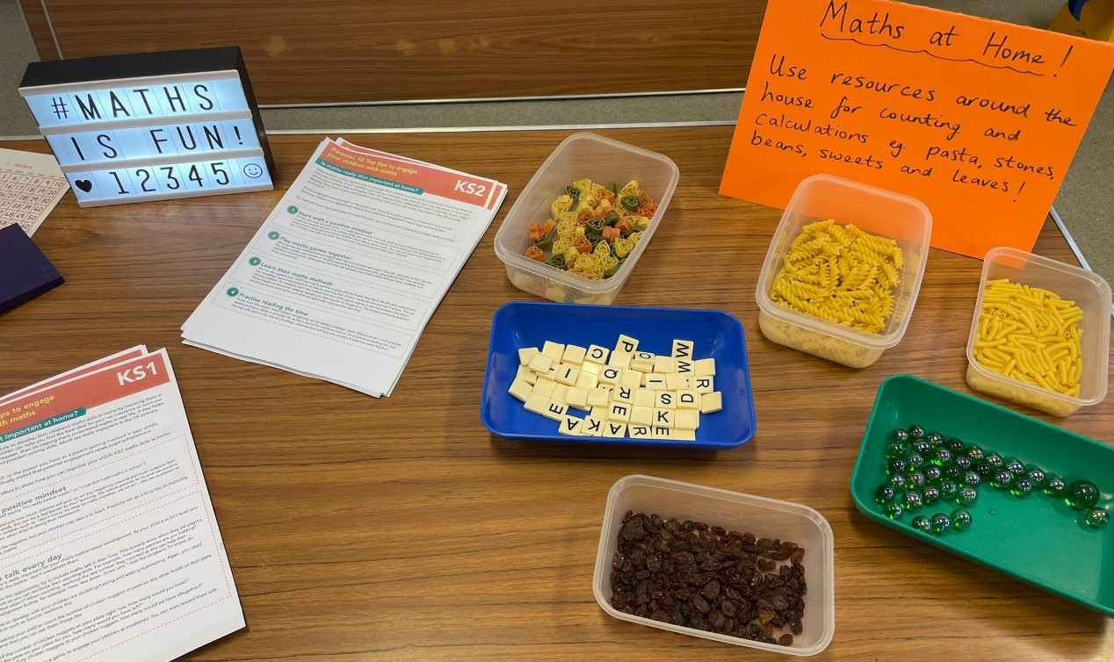
The parents were shown the concrete resources used in school as well as everyday resources to support maths at home.

Slide 3
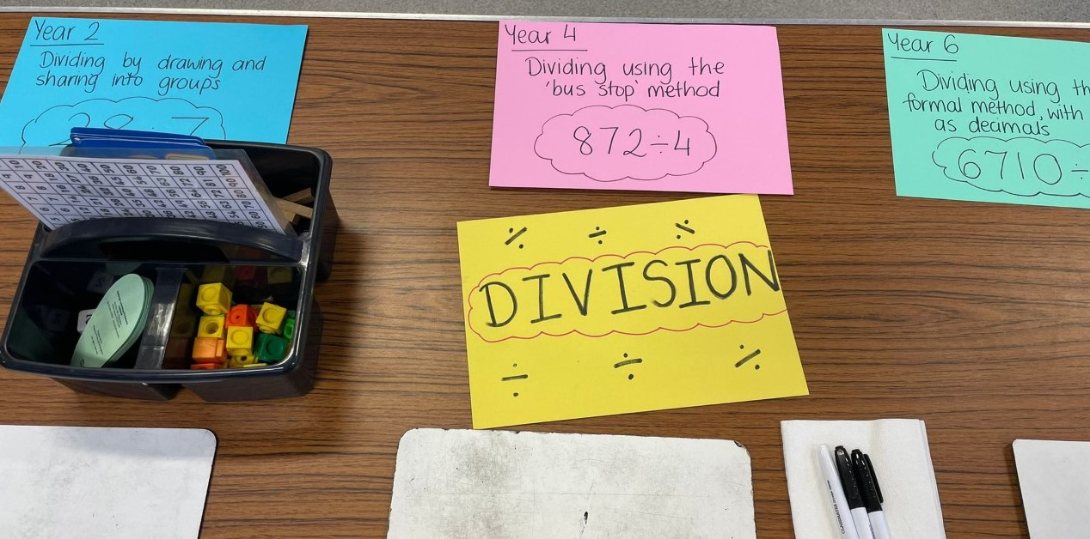
Our maths ambassadors demonstrated calculations for the parents.

Slide 4
Thank you to our maths ambassadors!

Slide 5
Thank you to all the parents who came. We hope it was a useful session for you.

